Slide 1
Majlis Ansarullah
Monthly Meeting
Feb 2016
This slide deck contains images licensed for the purpose of this presentation only.
No one is permitted to use the images for any other use, without prior permission.

Slide 2
AGENDA
Recitation of the Holy Quran (2:1-3)
Pledge
Reminder: Congregational Prayers
Monthly topic: Is the Holy Quran a part of our lives
Health topic: Nutrition
National Reminders/announcements
Local Reminders/announcements
Dua

Slide 3
Watching Our Congregational Salat!
Stick to Congregation Prayers for the Wolf Eats the One that has Strayed
The Messenger of Allāh, peace and blessings of Allāh be on him, said: "If there are three people, either in the town or in the desert, among whom prayer is not said in congregation but the devil will surely overcome them; so stick to the congregation for the wolf eats the one that has strayed away from the flock.“
(Abu Dawud)

Slide 4
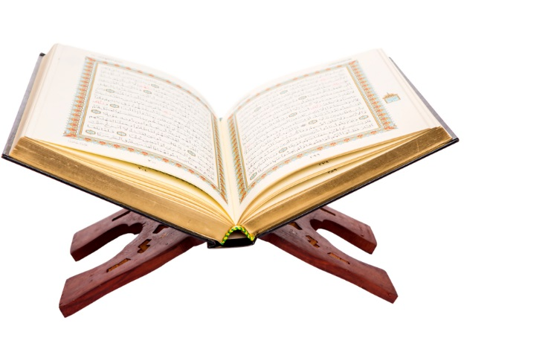
Is the Holy Quran a Part of My Life?

Slide 5



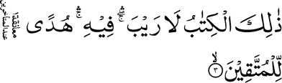
Click to listen the recitation
[2:1] In the name of Allah, the Gracious, the Merciful
[2:2] Alif Lam Mim.
[2:3] This is a perfect Book; there is no doubt in it; it is a guidance for the righteous,

Slide 6

How is the Holy Quran a “guidance for the righteous?”
Share your thoughts

Slide 7
Guidance from the Promised Messiah
God the Almighty has already answered all the possible questions that would have arisen in this age in the pages of the Holy Quran. There is no new branch of any science or no degree of advancement that can overshadow the Holy Quran. The comprehensive teaching and guidance that the Holy Quran offers to the world is not to be met with either in the Gospels or in the Bible (the Old Testament).
(Malfoozat vol. 10, pg. 400)

Slide 8

Discussion I
A person once told me that as:
I don’t do bad things or have bad habits,
I pray 5 times a day ,
I offer nawafal prayers at least once a week,
I regularly attend Jama’at and auxiliary meetings plus Ijtema and Jalsa Salana,
that it’s okay that I don’t have time to read the Holy Quran daily.

Slide 9
Option 1: You’ve prioritized your spiritual responsibilities appropriately.
Option 2: Daily Holy Qur’an recitation is still a must to ward off any other evils and receive blessings from Allah.
Option 3: Reading Holy Quran 2-3 times a week fulfills the obligation.
Option 4: Any other response?

Slide 10
Guidance from Holy Prophet Muhammad (saws)
Are you a citron or a date?
Abu Musa narrates, that the Prophet Muhammad (saw) said, "The example of a believer who recites the Qur'an and acts on it, like a citron which tastes nice and smells nice. And the example of a believer who does not recite the Qur'an but acts on it, is like a date which tastes good but has no smell. And the example of a hypocrite who recites the Qur'an is like a Raihana (sweet basil) which smells good but tastes bitter And the example of a hypocrite who does not recite the Qur'an is like a colocynth ( also called bitter apple) which tastes bitter and has a bad smell."
Sahih al-Bukhari Book 66, Hadith 84

Slide 11

Discussion II
At this point in your son’s life, he states that he can dedicate only 10 minutes for the Holy Quran before going to school/work. He comes to you to seek advice on how best to use this time.
Notes:
Need to impress the importance of not only reciting HQ, but going over its meaning.

Slide 12
Option 1: Advise him to read 2 rukus of the Holy Quran in Arabic with correct pronunciation.
Option 2: Advise him to read 1 ruku of the Holy Quran in Arabic with translation.
Option 3: Advise him to read 2-3 verses of the Holy Quran in Arabic with translation, focusing on the true message and instruction laid out.
Option 4: Any other response?

Slide 13
Guidance from Hazur (aba)
Huzur (aba) said, “Recently one of our detractors said that if the Promised Messiah (as) was a Prophet why did he ask his Community to follow Imam Abu Hanifah. Promised Messiah (on whom be peace) certainly did not say anywhere that Imam Hanifah should be followed but with reference to the Holy Qur’an once it was mentioned in an assembly of the Promised Messiah (as) that according to Hanafi creed only reading the translation of the Qur’an was essential. The Promised Messiah (as) replied, ‘if this was the creed of the great Imam, it was his mistake.’ God sent the Promised Messiah (on whom be peace) as a source of real safeguard of the Qur’an in this age and he advised his Community to understand the Qur’an and to love it in numerous places.
(Excerpt from Friday Sermon, October 9, 2015)

Slide 14

Discussion III
A fellow Ahmadi brother confides in you that he doesn’t feel that reading the Holy Quran is as important in today’s world which is why we now have the writings of the Promised Messiah and Hazur’s sermons. What is your main response to him?

Slide 15
Option 1: Explain to him that the Holy Quran is unique in that it can be applied to any individual and for any time period after the advent of the Holy Prophet (saws)
Option 2: Explain that the Promised Messiah (as) was sent to interpret the Holy Quran for us for modern times. Focus on reading his 80+ writings.
Option 3: We need to prioritize listening to Hazur’s sermons as they effectively summarize the guidance of the Holy Quran through the lens of the teachings of the Holy Prophet and Promised Messiah to be applied to today’s issues.
Option 4: Any other response?

Slide 16
Guidance from the Promised Messiah (as)
Holy Quran is for PAST, PRESENT, FUTURE
It is a specialty of the Holy Quran and it imparts its teachings to all the three types of the people. One and the same thing educates (produces workable teaching) the illiterate, the man of the moderate knowledge and understanding and to the highly talented philosopher. Indeed this place of pride belongs to the Holy Quran and to no other book that every type of people is blessed through it according to his personal capacity.
(Malfoozat Vol. I, p. 212)

Slide 17

A Short Video from Friday Sermon, Dec 16, 2011

Slide 18
Translation of video
In this era, Hazrat Massiah Maud (as) has made an immense effort, and this was the purpose of his coming, that we give precedence to the Holy Quran, more than anything else in this world. And give it such an honor that nothing else can compete with that. We don’t only limit our honoring of the Holy Quran to what generally non-Ahmadi Muslims do by putting the Holy Quran in beautiful covers, in beautiful shelves and beautiful boxes. The real honor of the Holy Quran and its love is to try your best to act on its commandments. And that we make its do’s and don’ts part of our lives. From whatever, God has forbidden us, we refrain from that. And for what has been commanded us to do, we try our best to do that using all our abilities and powers. Keeping the fear of Allah in our hearts, it [the Holy Quran] should be recited. Hazrat Masih Maud (as), at many places in his books, and spoken words, has described importance of the Holy Quran. He has laid out those expectations which he has from an Ahmadi or a person who has done the Bai’at. So, it is essential for us to fill our homes with the recitation of the Holy Quran. It is also needed that we read the translation along with its recitation. So that we can understand its commandments. At homes, in front of the children, it should be attempted that along with its recitation, we talk about and devise various ways to understand its meaning. We should not make a habit to do mere recitation. Rather we should try to bring up various small matters from the Holy Quran and present in front of children so that they begin to like it.

Slide 19
اپنے جائزے لیں -
Self analyze yourself, KMV
Where do we stand?
In the past week,
how many rukus did you read in Arabic?
How many rukus did you read in your native language?
How many rukus did you read deeply with full pondering over the meanings of the words of the Holy Quran and apply to your life’s activities?
Add the three numbers together.
(Keep it to yourself.. the “score” is for you!)

Slide 20
How to Improve?
اپنے اندر پاک تبدیلیاں پیدا کریں -
Bring about pious changes in yourself
0
Combined Score
18+
Make reading the Holy Quran part of your daily routine. Don’t just read the Arabic “blindly.”
Make an earnest effort to focus on regularity and with deeper study of the meaning.
Make an active effort to teach what you’ve learned to your family, friends and fellow Jam’aat members.

Slide 21
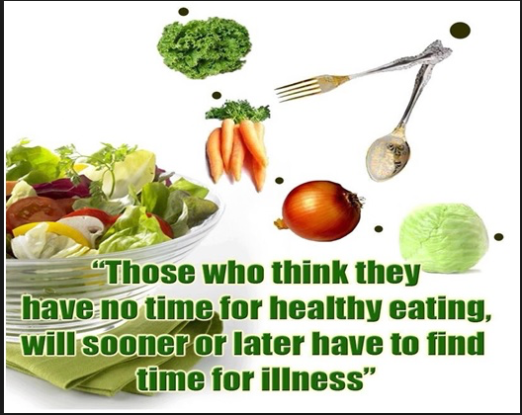
Health Topic: Nutrition

Slide 22
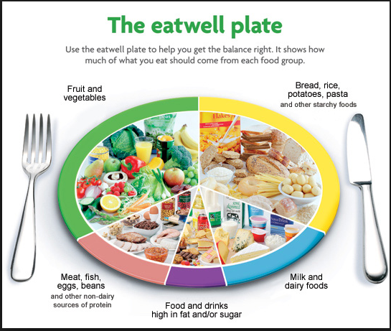

Balanced Diet
Balanced Diet is all an inclusive Lifelong Eating Habit that Promotes Health, Prevents Sickness, Deficiency and Over-nutrition
A Balanced diet gives your body the nutrition it needs to function properly
The majority of daily calories should come from fresh fruits and vegetables, whole grains, and lean proteins
Healthy diet provides adequate calories, vitamins and other nutrients from all food classes in a balanced manner
Balanced Diet is not a Food Fad or Quick Fix - It is a lifestyle

Slide 23
Why Balanced Diet?
Balanced Diet is an essential step towards a happy and healthy lifestyle
A healthy diet protects against diseases like obesity, Diabetes, Heart Disease, Osteoporosis, Arthritis and some forms of cancers
A balanced diet is essential to maintain healthy weight
Healthy Diet is associated with Long and Healthy Life
Healthy eating is a good opportunity to enrich life by experimenting with different foods
The benefits of eating a wide variety of foods are also emotional
You will look better, feel better and Age better
Healthy Diet is essential to live well with of chronic illnesses (Heart, Diabetes)

Slide 24
How to Eat Well and Balanced
Consume a Variety of Foods and Keep an Eye on Portions
Eat Plenty of Produce - 2½ cups of vegetables and 2 cups of fruit a day, for a 2,000-calorie diet
Get More Whole Grains; at least half of your grains should be whole grains, such as whole wheat, barley and oats
Limit Refined Grains, Added Sugar such as white bread, regular pasta and most snack foods
Enjoy More Fish and Nuts; recent research suggests that these foods tend not to promote weight gain (Satiety)
Cut Down on Animal fat, especially from red meat and processed meat
Shun Trans Fats - such as commercial baked goods, snack foods stick margarines French fries, etc
Watch Your Calcium and Vitamin D - These nutrients are vital for bone health - Low Fat Dairy Products
Choose Food Over Supplements; Vitamins and Supplements cannot substitute for a healthy diet
Be Aware of Liquid Calories; Beverages supply more than 20 percent of the calories in the average American’s diet

Slide 25
National Reminders
Four Priorities for 2016
At least 50% of Tajnid to attend monthly meetings where we discuss our Khalifa’s vision: “Save yourself and your families from a fire” in interactive discussions.
Help establish a culture of congregational Salat.
Help strengthen the love of Holy Quran.
More than 50% Tajnid to attend National Ijtima.

Slide 26
Local Reminders
1
2
Dua

